Slide 1
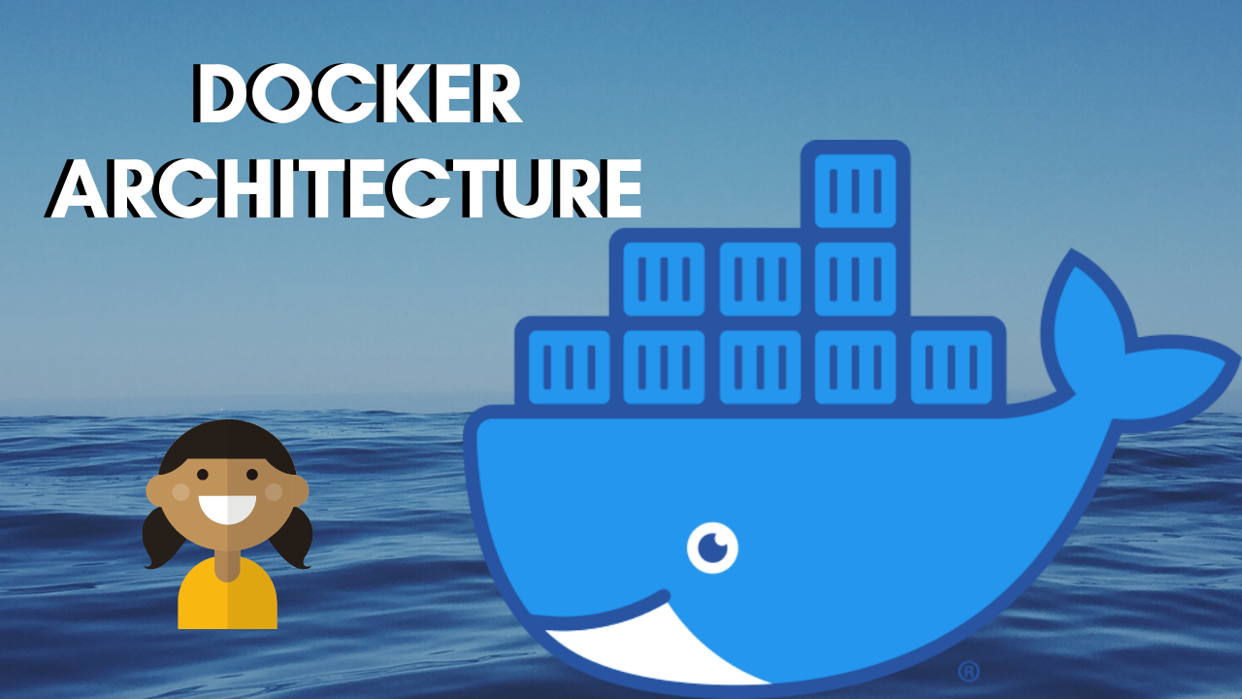

Slide 2
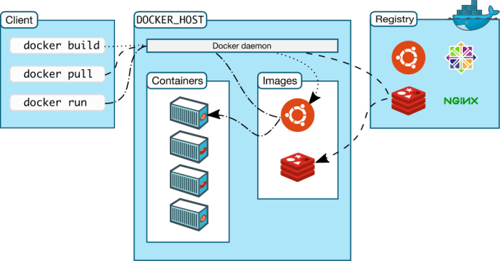
DOCKER ARCHITECTURE
It follows Client-Server architecture consisting of three parts :

Slide 3
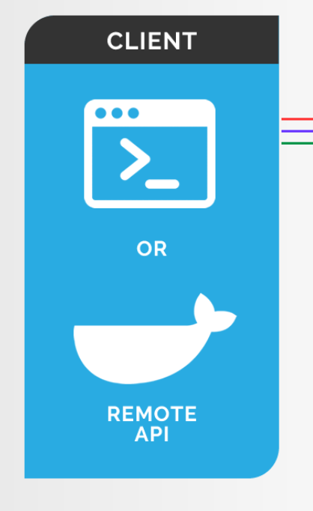
Docker Client
Docker user can interact with Docker through a Client.
Docker Client provides CLI tool to interact with Docker Daemon.
It is an interface that allows communication between the user and the Docker daemon using REST API (http request).
The Docker client can communicate with more than one daemon.

Slide 4
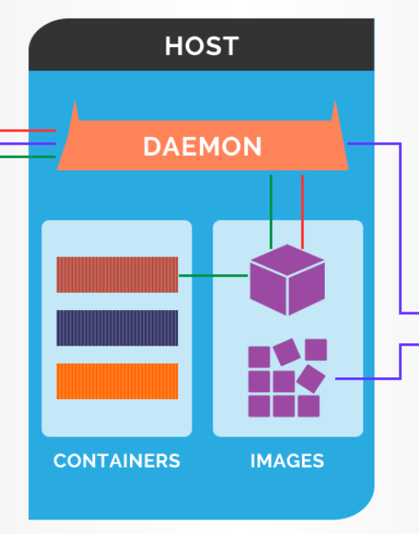
Docker Host
The Docker host provides a complete environment to execute and run applications.
In Docker host, we have Docker daemon and Docker objects
Docker Daemon
Docker daemon listens for Docker API and builds an image on user input and saves it in the registry.
Moreover, one daemon can easily communicate with other daemons in order to manage Docker services.
Docker Objects
These are your main components of Docker: your containers and images.
Containers are instances of Docker images that can be run using the Docker run command. Container images are read-only template with instructions for creating a Docker container.

Slide 5
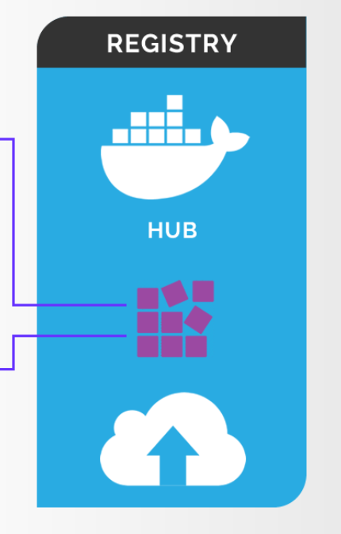
Docker Registry
Docker registry is a repository for storing Docker images which is used for creating Docker containers.
Docker Hub is a public registry that anyone can use, and Docker is configured to look for images on Docker Hub by default.
You can even run your own private registry.
One of the advantages it offers is we can create our own registry as well.

Slide 6
Thank You!

